Slide 1
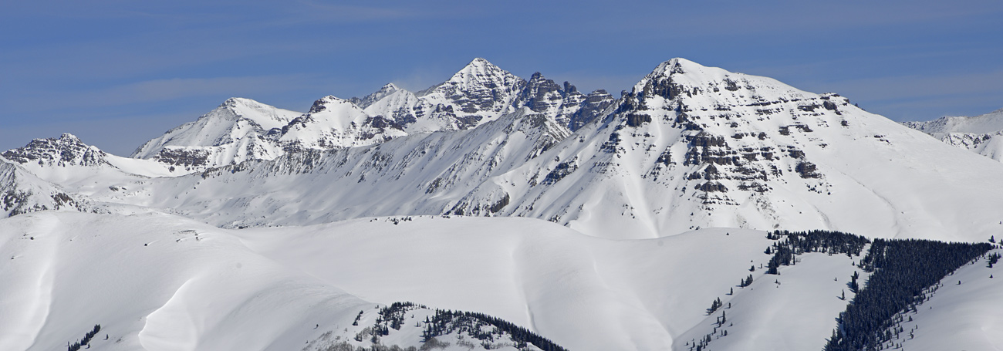
Team Castle Peak
MSBX 5420 Final Presentation
CBC Coronavirus/COVID-19 News Analysis
Mico L., Paul T., Zhe Z., Maryann P., Alex G.
Notes:
Paul Intro?

Slide 2
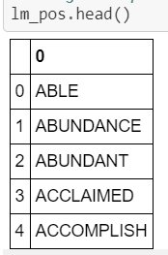
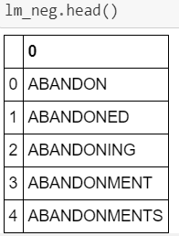
Local Analysis - Sentiment Analysis Methodology
First, a little more cleaning…
Positive & Negative Dictionaries
Bag-of-words Approach
Calculate a Sentiment Score
Notes:
Paul

Slide 3
Local Analysis - Sentiment Analysis/Word Clouds
Calculated how positive and negative an article was
If an article was more positive we called it a positive article
Vice Versa for negative articles
251/2816 or 8.9% of all articles can be considered positive
Notes:
Alex

Slide 4
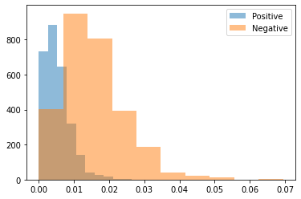
Local Analysis - Sentiment Analysis/Word Clouds
Positive/negative scores
Range of positive scores
Range of negative scores
Notes:
Alex

Slide 5
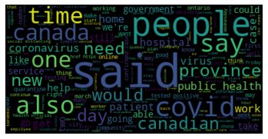
Local Analysis - Sentiment Analysis/Word Clouds
WordCloud for positive articles (251)
Canada is more optimistic?
Hope in the government
Notes:
Alex

Slide 6
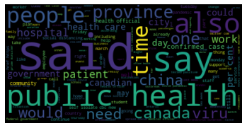
Local Analysis - Sentiment Analysis/Word Clouds
WordCloud for negative articles
Talking about China
Number of patients
State of hospital
Notes:
Alex

Slide 7
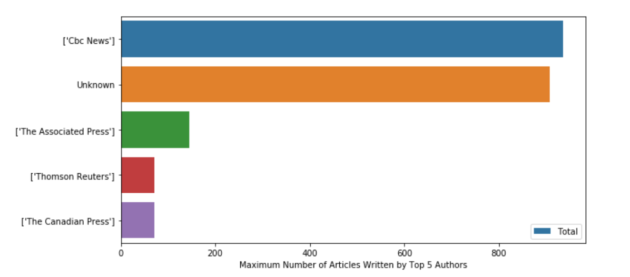
Analysis - Vocab/Word Counts
Maximum Number of Articles Written by Top 5 Authors

Slide 8
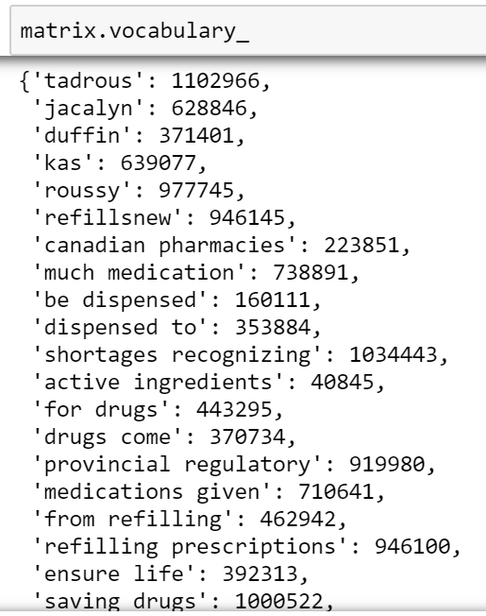
Analysis - Vocab/Word Counts
CountVectorizer() function
Vocabulary count

Slide 9
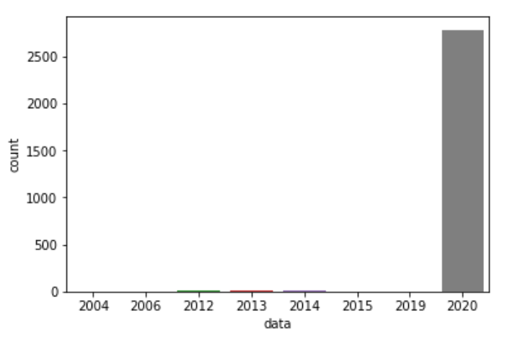
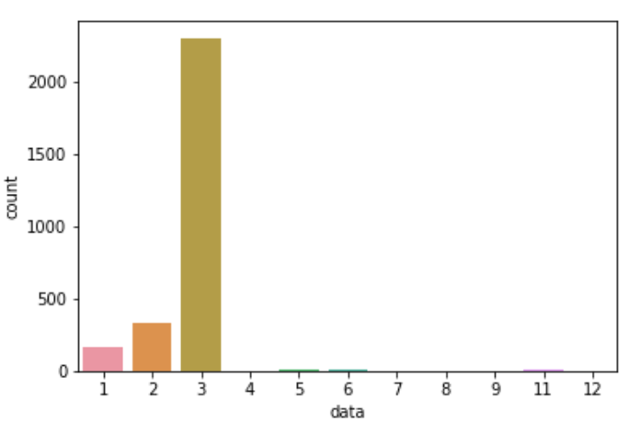
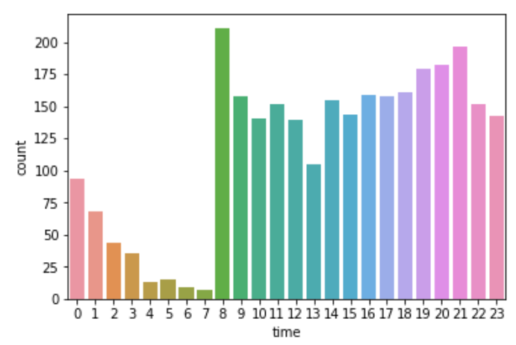
Analysis - Vocab/Word Counts
Time analysis by years, monthes, and hours

Slide 10
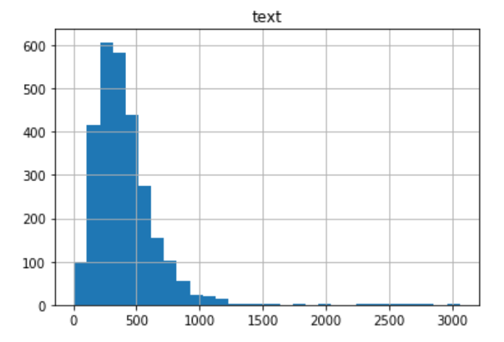
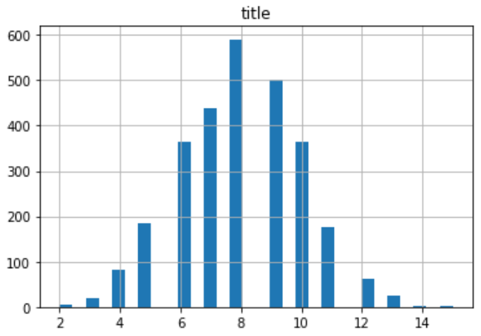
Analysis - Vocab/Word Counts
Word count for each text Word count for each title

Slide 11
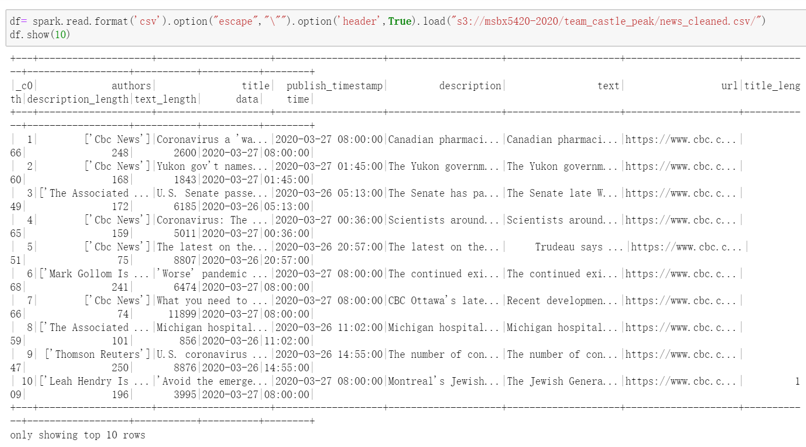
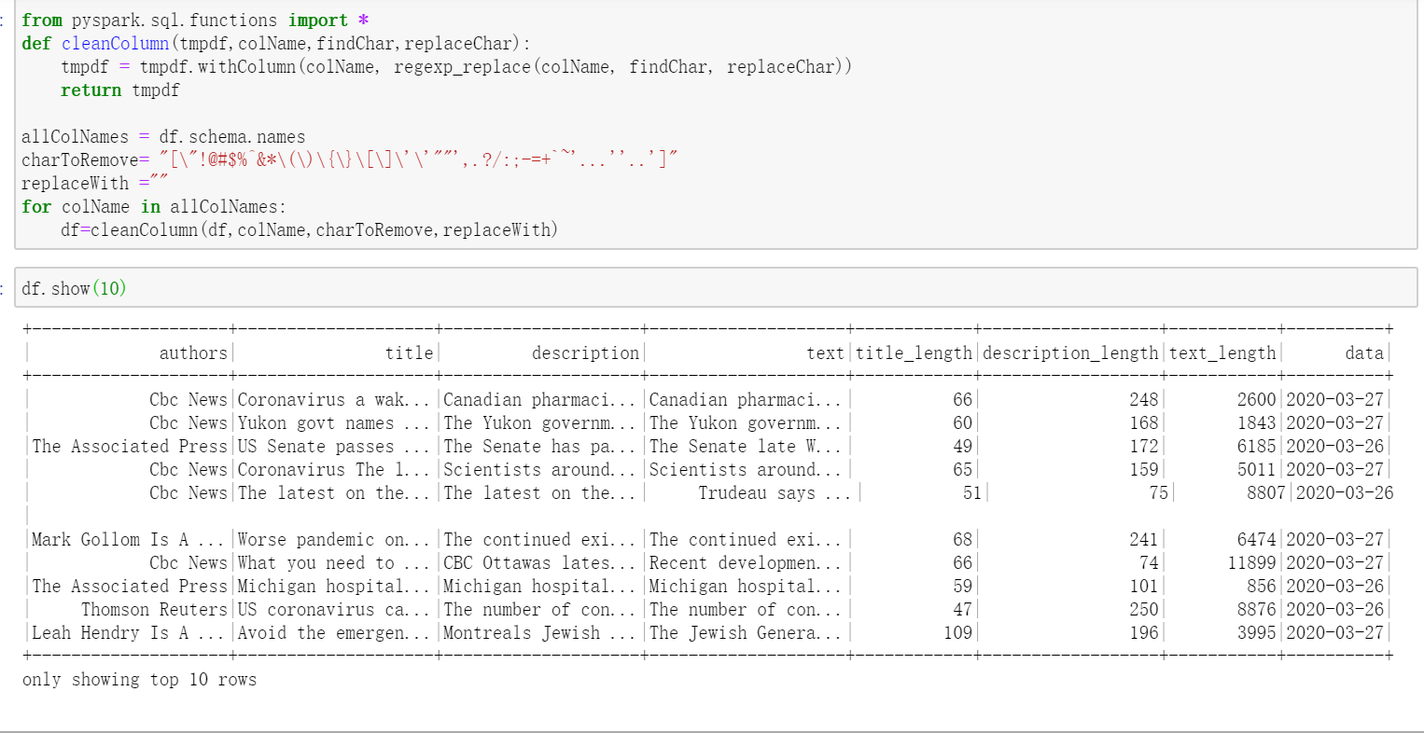
Cluster Analysis -
After
Before

Slide 12
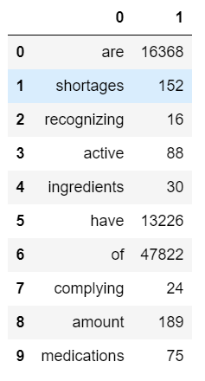
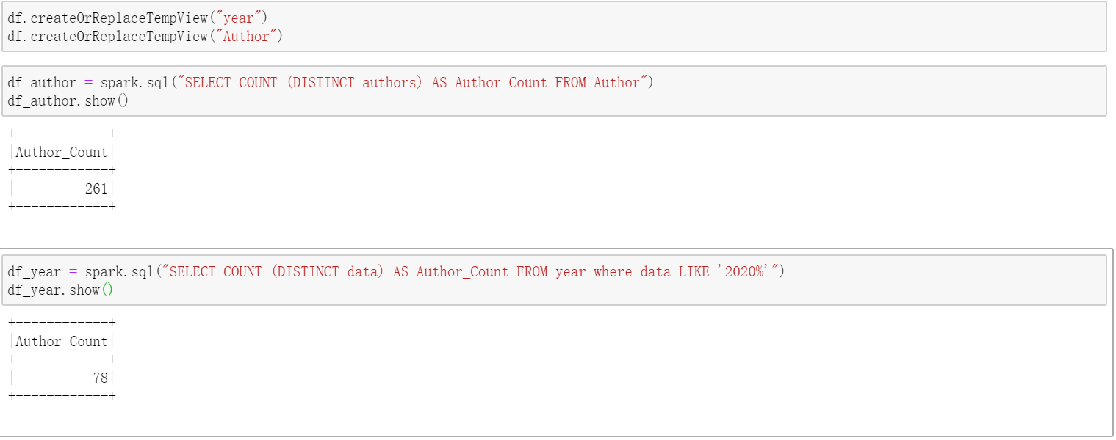
Top 10 words for Text
Temporary View by Spark DataFrame

Slide 13
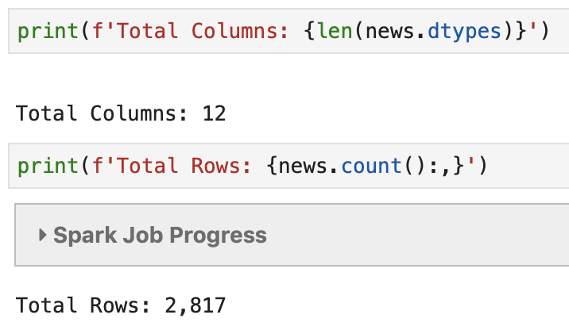
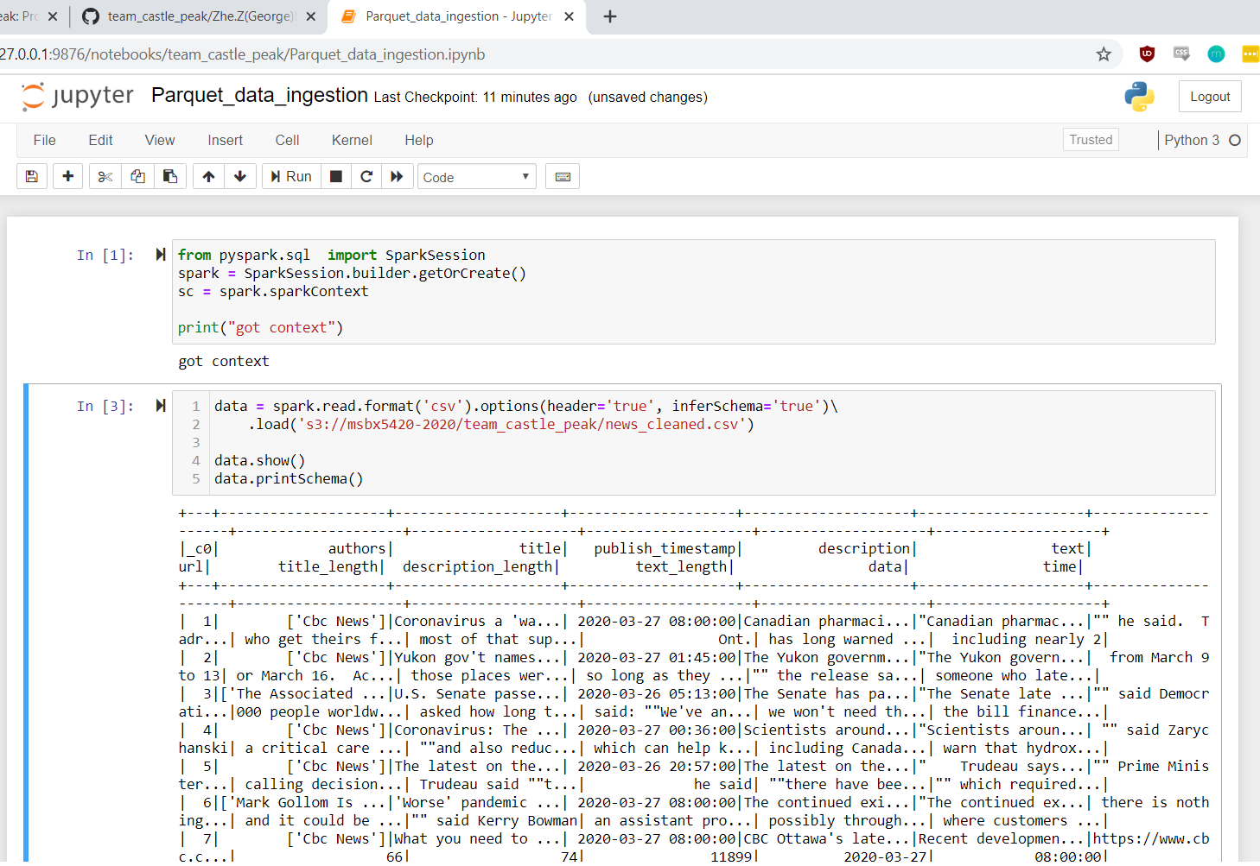
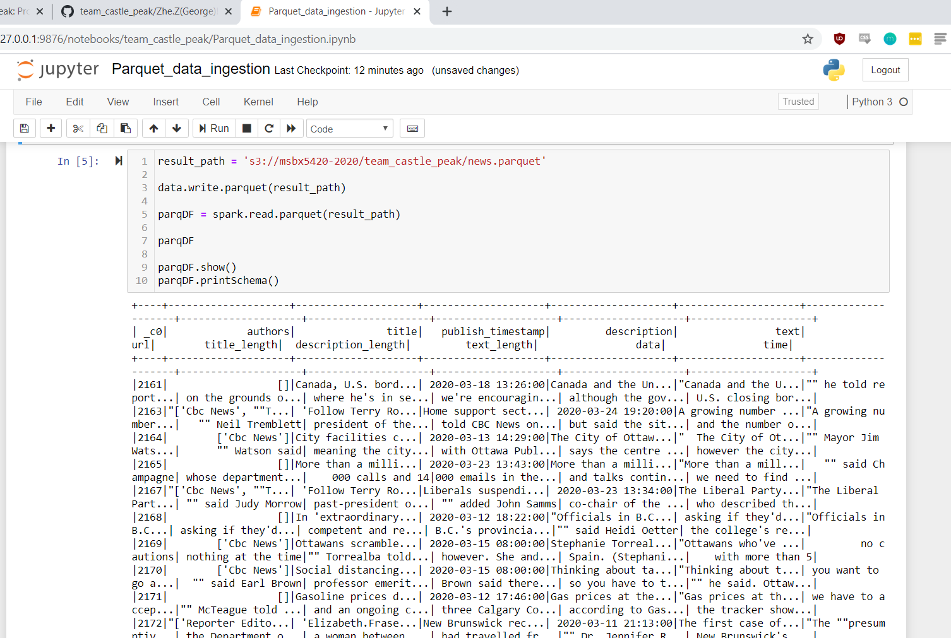
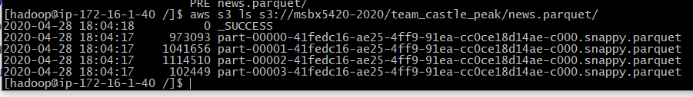
Cluster Analysis - Data Ingestion (Parquet)
Notes:
Maryann or Paul

Slide 14
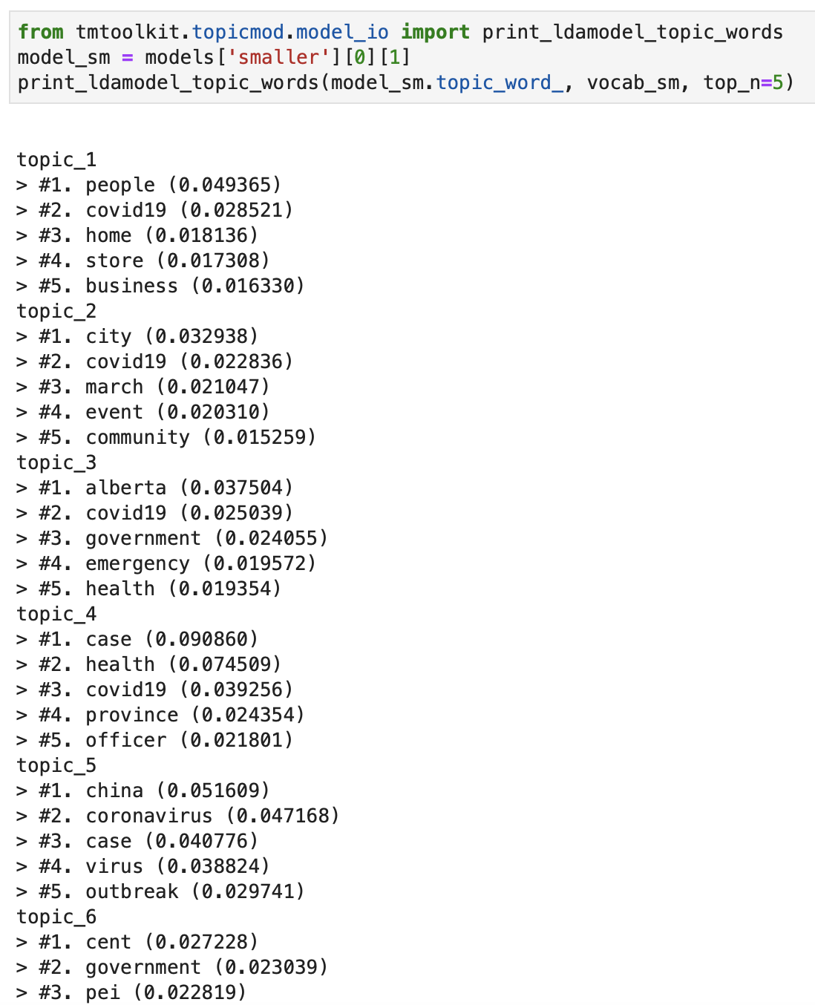

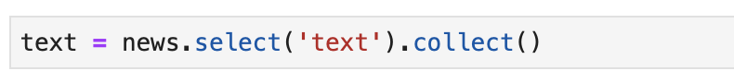
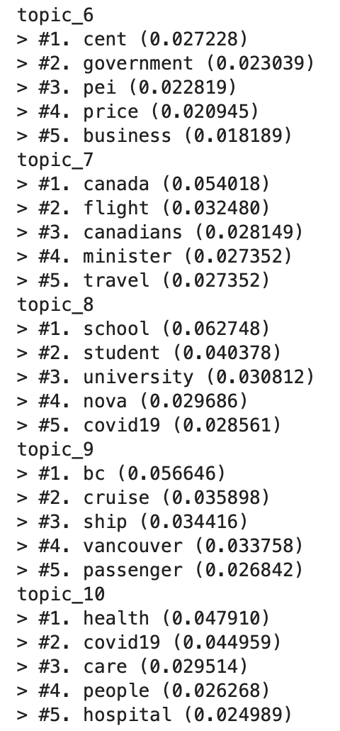
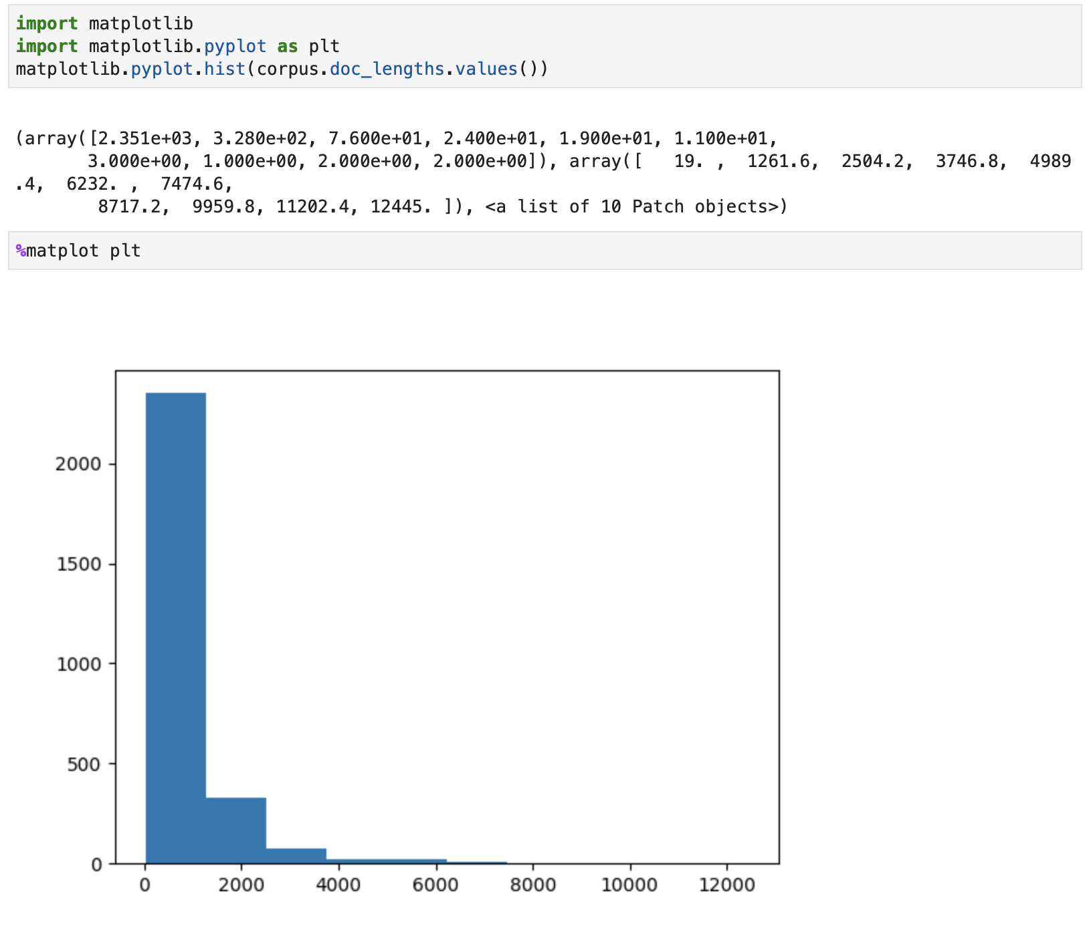
Topic Modeling

Slide 15


Process & Challenges
Agile...ish
Standup Meetings
Iterative Development
Reqs
Design/Dev
Test
Repeat
Deploy
Modular Organization
Time Crunch
Notes:
Paul

